Slide 1
Jermyn Borough Council Meeting 2/18/21

Slide 2
Meeting Agenda

Slide 3
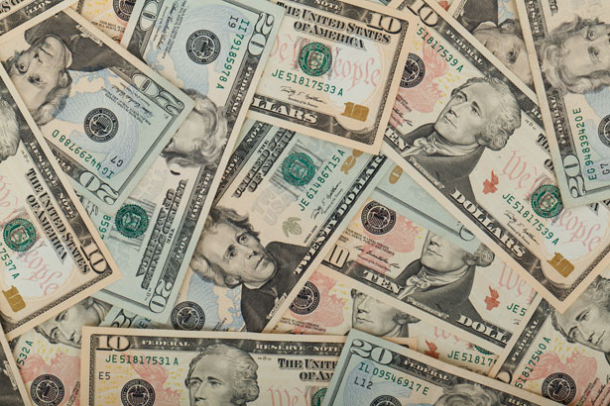
Treasurer’s report
2/18/21
ASSETS
Capital Reserve - DPW 13,497.72
Capital Reserve - Police 3,470.18
Crime Watch Fund 755.44
General Fund – Community 89,576.90
General Fund - FNB 2,016.44
Holiday Lights Fund 543.90

Slide 4
Treasurer’s report
2/18/21
ASSETS
Investment - General Fund 1,001.39
Investment - Liquid Fuels 33,810.60
Investment - Paving Fund 11.91
Investment - Recycling 5,002.92
Investment - Refuse 2,604.65
Liquid Fuels - FNB 14,710.37
Petty Cash 151.42
Recreations Fund 11,466.12
Recycling - Community 9,951.30
Refuse Checking - FNB 17,252.17
Total Checking/Savings 205,823.43

Slide 5
Treasurer’s report
Accounts Payable 38,726.92

